Slide 1

Making C++ and the STL Work in the Linux / Windows Kernels
Rian Quinn, Ph.D., quinnr@ainfosec.com
Brendan Kerrigan, kerriganb@ainfosec.com
Notes:
Give a brief description of the project:
- Bareflank is a new, open source, lightweight hypervisor, written in C++ 11/14, designed to facilitate hypervisor research.

Slide 2
Motivation
Too Focused On Virtual Machines
Hypervisors are used for more than virtualizing servers and running Windows on a Mac
In fact, there is a whole field of research where hypervisors are used without any guest virtual machines.
MoRE: https://github.com/ainfosec/MoRE
SimleVisor: https://github.com/ionescu007/SimpleVisor
HyperPlatform: https://github.com/tandasat/HyperPlatform
HyperBone: https://github.com/DarthTon/HyperBone
Notes:
There is a need for an open source hypervisor that is easy to use for non-traditional hypervisor research, but powerful enough that it could be used to compete with existing hypervisors like Xen, KVM, VirtualBox, etc…

Slide 3
Motivation
Too Focused On Virtual Machines (continued)
Existing open source hypervisors focus too much on legacy support and guest virtual machines:
Xen: www.xenproject.org
KVM: http://www.linux-kvm.org/page/Main_Page
VirtualBox: https://www.virtualbox.org/wiki/Downloads
These hypervisors are painful to work with when conducting less traditional hypervisor research.
Thus researchers always start the same way, spending months standing up a hypervisor before working the actual project.
Notes:
Not saying that guests should not be support, but rather, it should not be the focus. The hypervisor should be built in a way to support all kinds of use cases and not just guests.

Slide 4
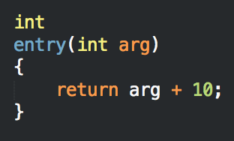
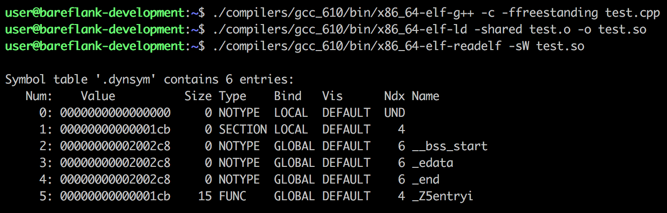
Where do we start?
Goal: Inside a kernel driver, execute a really, really simple C++ program
Notes:
Use VirtualBox as our example
We want to click on an icon in Windows, and run a VM.
To do this, we will need a driver that is capable of launching our hypervisor so that it can run the desired VM
Create a simple program:
Link as a shared library, which removes a lot of the ”executable” requirements of a typical binary
There are no relocation (so the GOT can be ignored)
Generates a simple piece of executable code, whose result can be verified to prove that our ”C++” is executing.

Slide 5
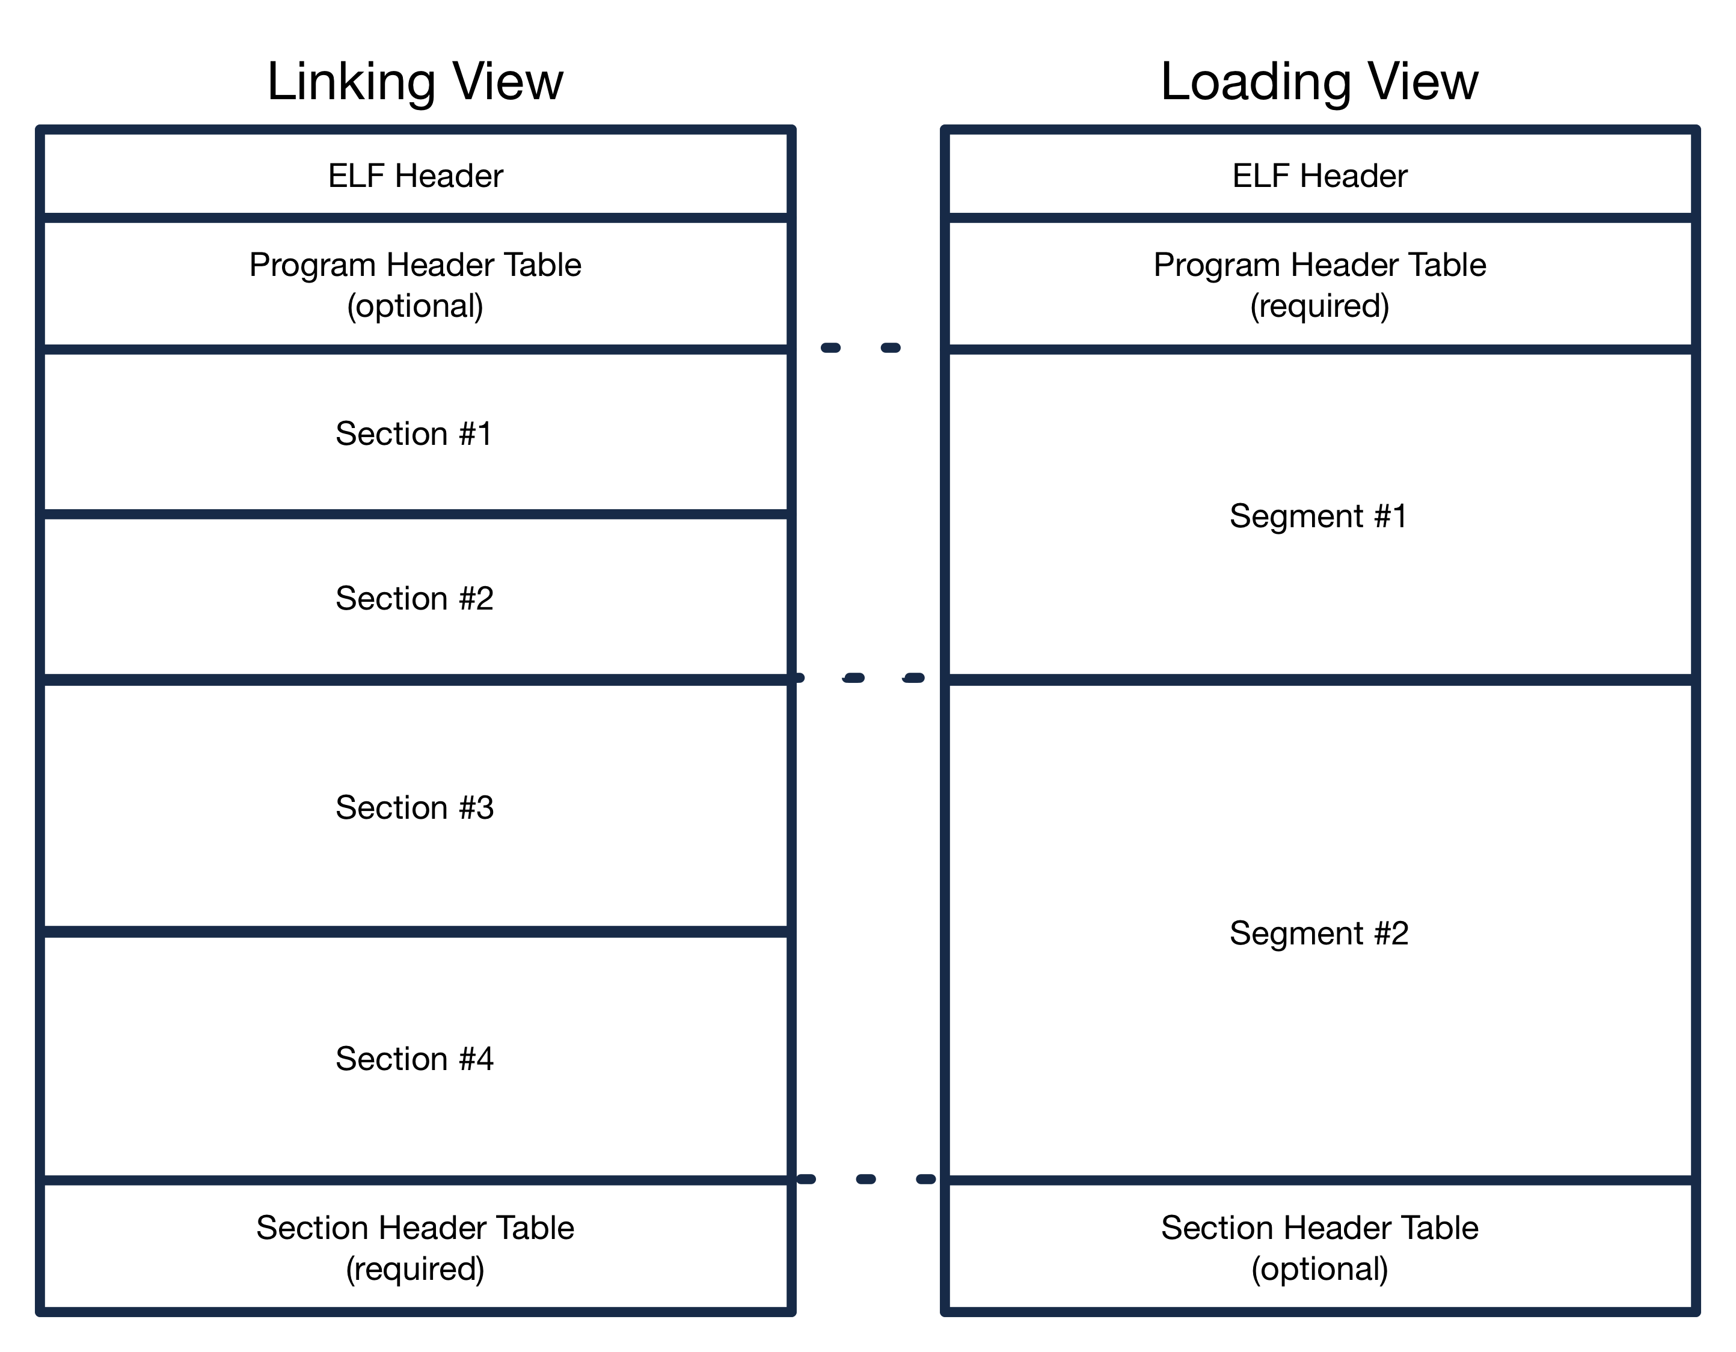
ELF Loader
Overview
Will need an ELF loader to load our C++

Slide 6
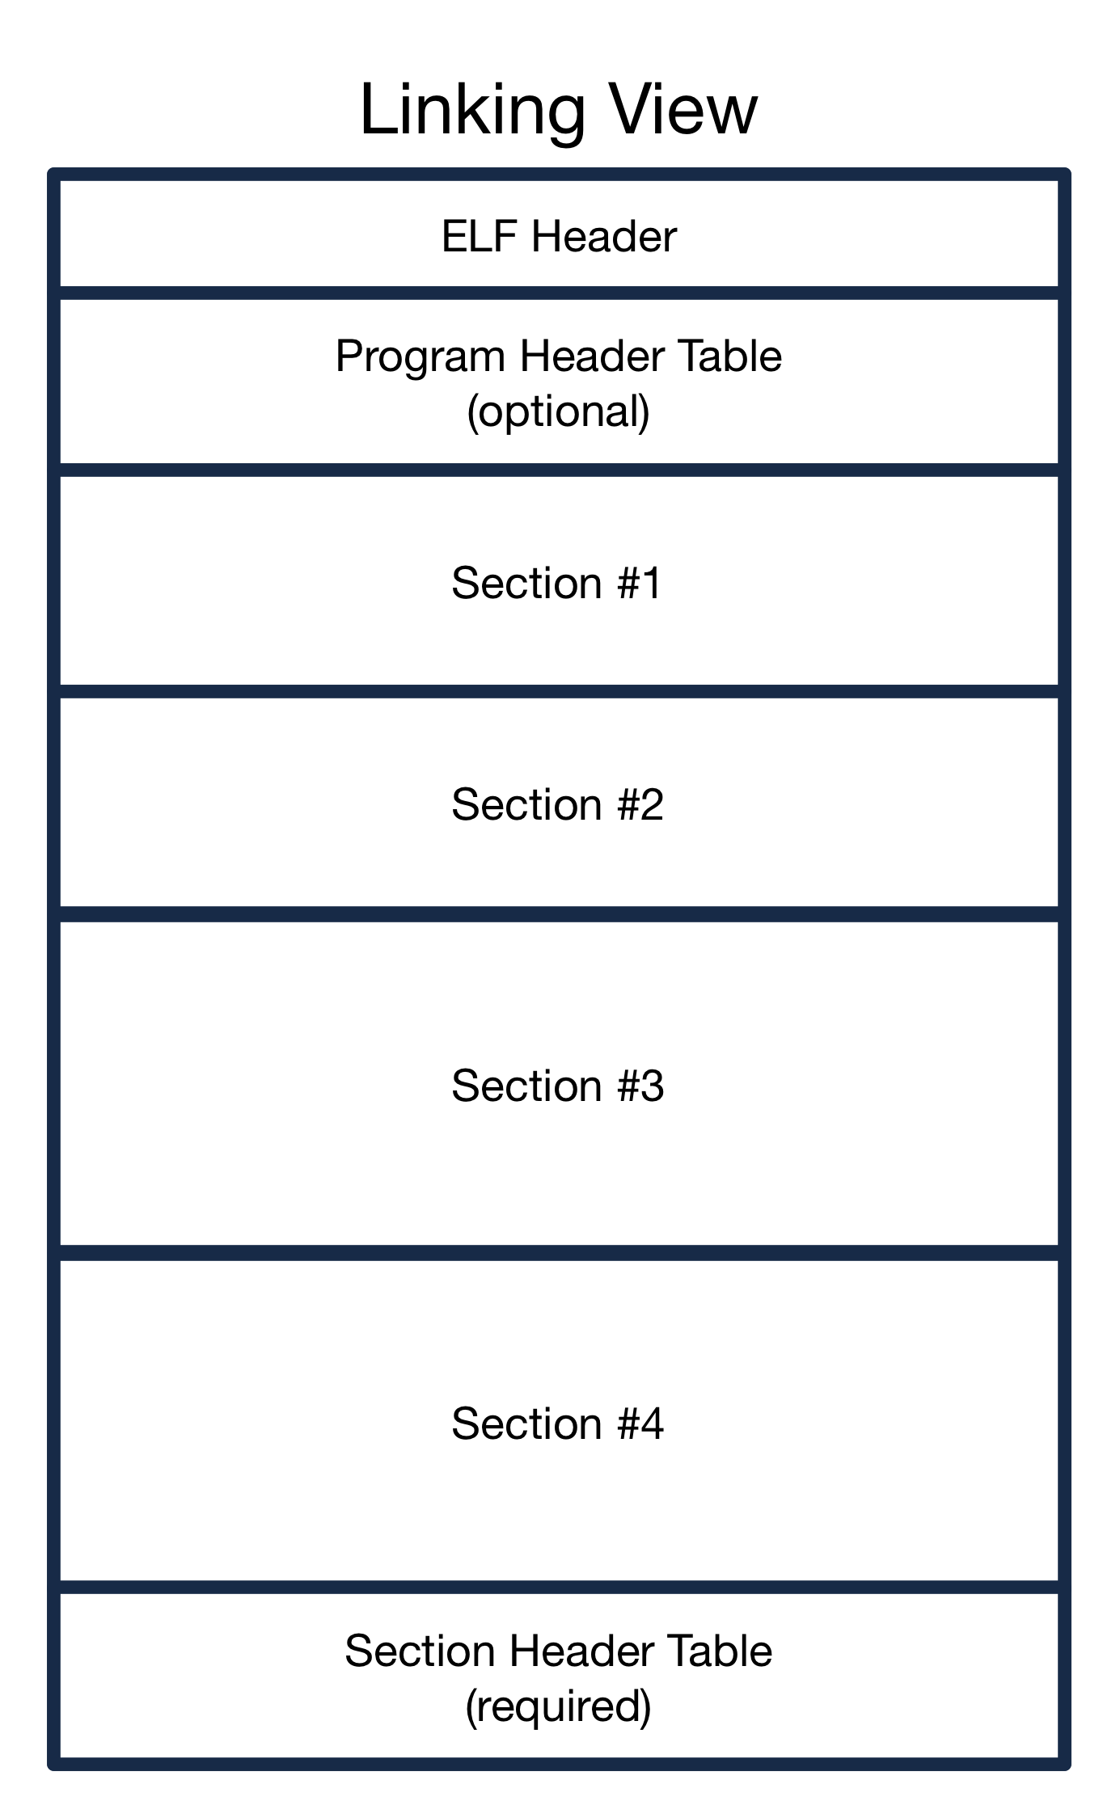

ELF Loader
Linking
Each ELF file is divided into a set of “sections”.
Each section provides different resources that are needed to execute the code in the ELF file
Examples include:
.text
.data
.bss
.ctors/.dtors
.eh_frame

Slide 7
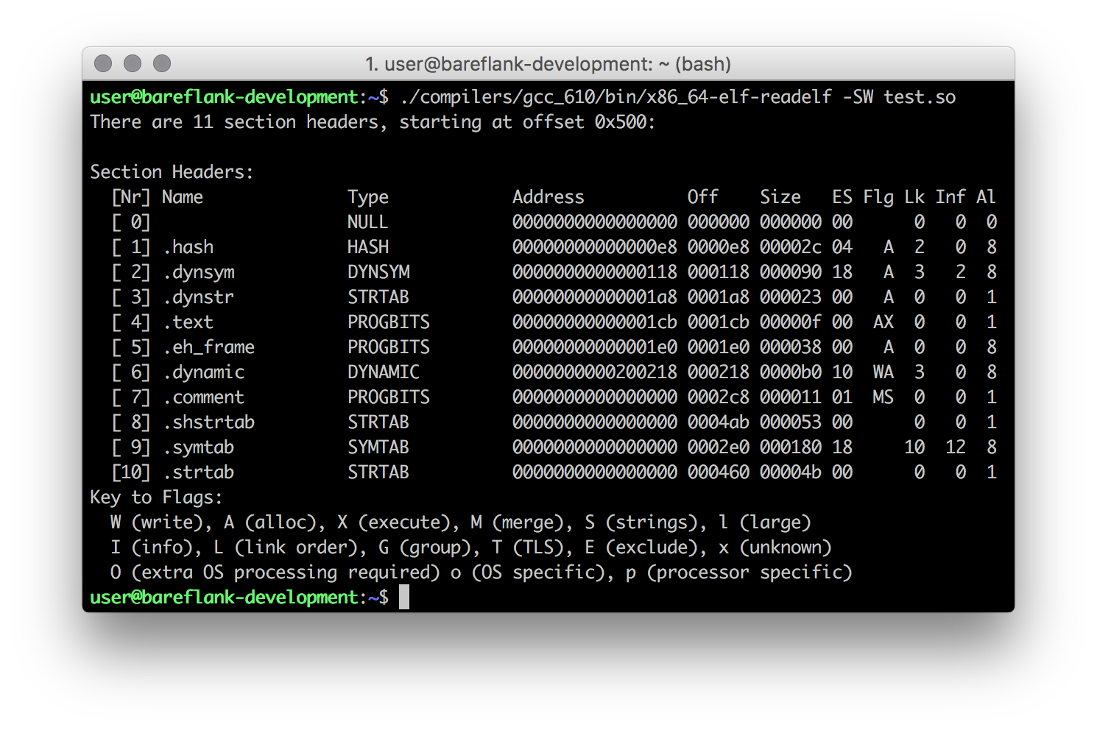

ELF Loader
Linking (continued)

Slide 8
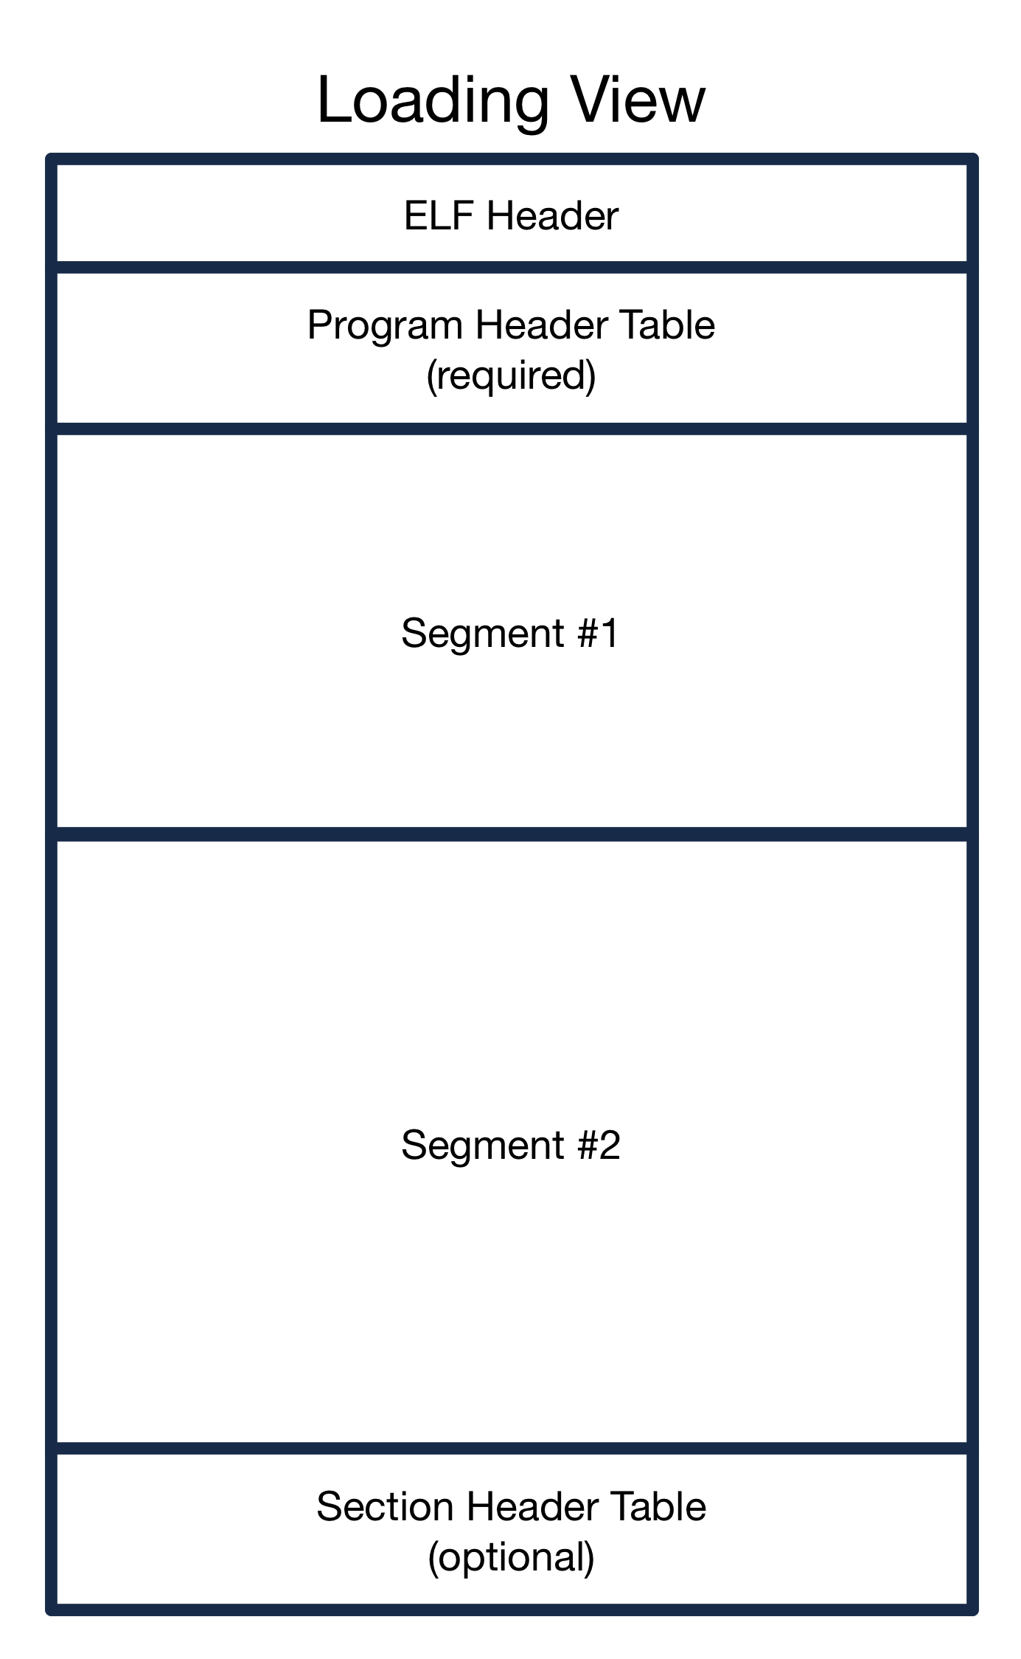
ELF Loader
Loading
In an ELF file, all of the sections are grouped into “segments”.
Each segment provides the ELF loader with instructions as to where to load the segment as well as what type of memory to load the segment into
For Bareflank, all of the modules have a ”R/W” and a “R/E” segment

Slide 9
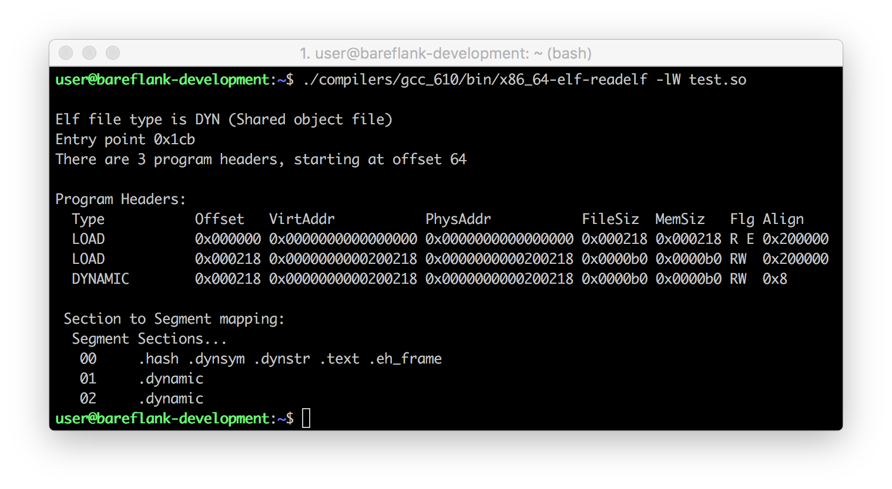

ELF Loader
Loading (continued)
We’ll explain this later!!!
Notes:
In our example, the ELF binary places the “code” in a read / execute memory segment, and then provides a small read / write segment
RW is usually placed after read / execute segments so that “heap” memory can grow past the end of a program
Since this was compiled for 64bit, the alignment is set to 2MB for page alignment (there are ways to reduce the virtual memory waste if needed)

Slide 10
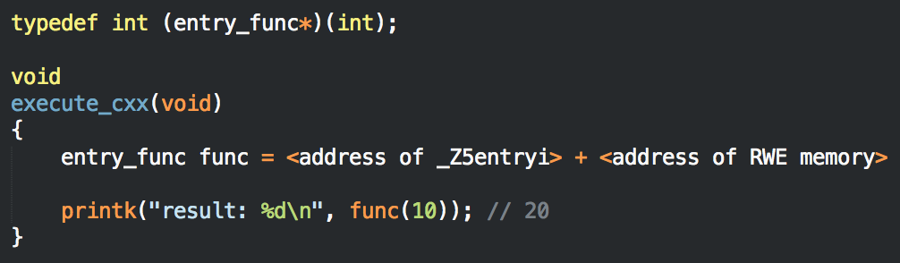
Executing C++ Example in the Kernel
Create skeleton OS driver
Allocate RWE memory for ELF binary (lets ignore W^E for now)
Copy segments into memory
Get address of “_Z5entryi” from “.dynsym”
If all goes well, we should see “20”, otherwise:

Slide 11


Slide 12
Now Onto The Interesting Stuff
Once we have a working ELF loader (sorry, no time to dive deeper into ELF, but in the end, you need a complete ELF loader and a couple of beers)
Global Construction / Destruction
C Runtime Library
Red Zone
Libc++
Wrapper Script
Weak / Strong Symbols and dynamic_cast<>
Stack unwinding

Slide 13
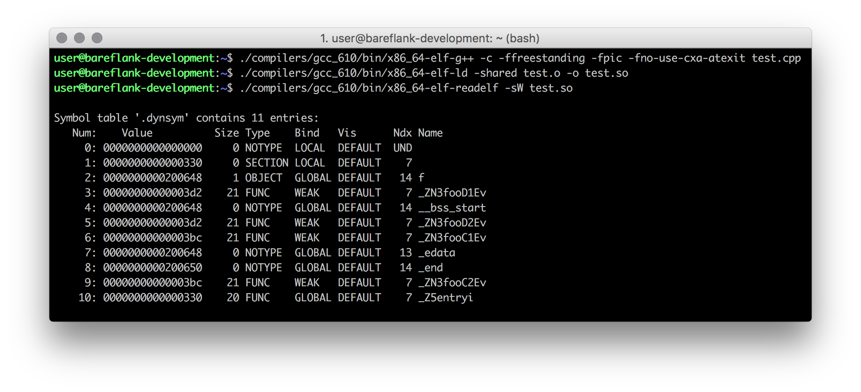
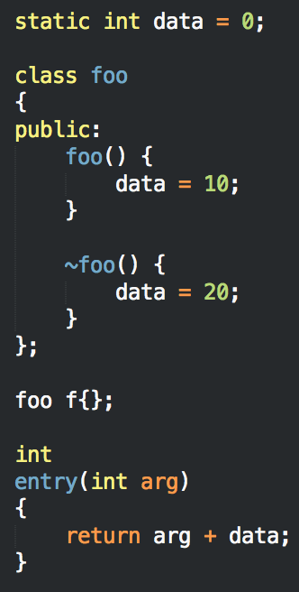
Global Construction / Destruction
Notes:
Using the example above, we would see this function return 10, since the ctors / dtors have not been executed.
Really simple program that globally defines a class and uses the constructor / destructor to change a local variable, which is returned by the “entry” function.
Interesting note: notice how “static int data” removes “data” from the symbol table. Defining variables as global might reduce linking times, certainly reduces size of ELF binary.
Easy to see the constructor and destructor, but how are they executed?

Slide 14
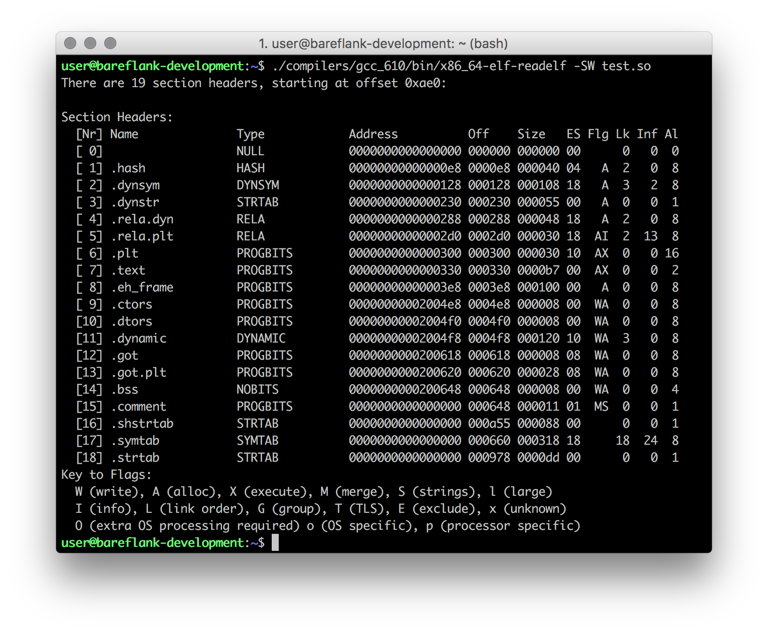
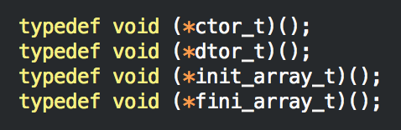
Notes:
.ctor / .dtor sections
- Contains a list of “void func(void)” functions
- Notice the size if “8” and the alignment is “8”

Slide 15
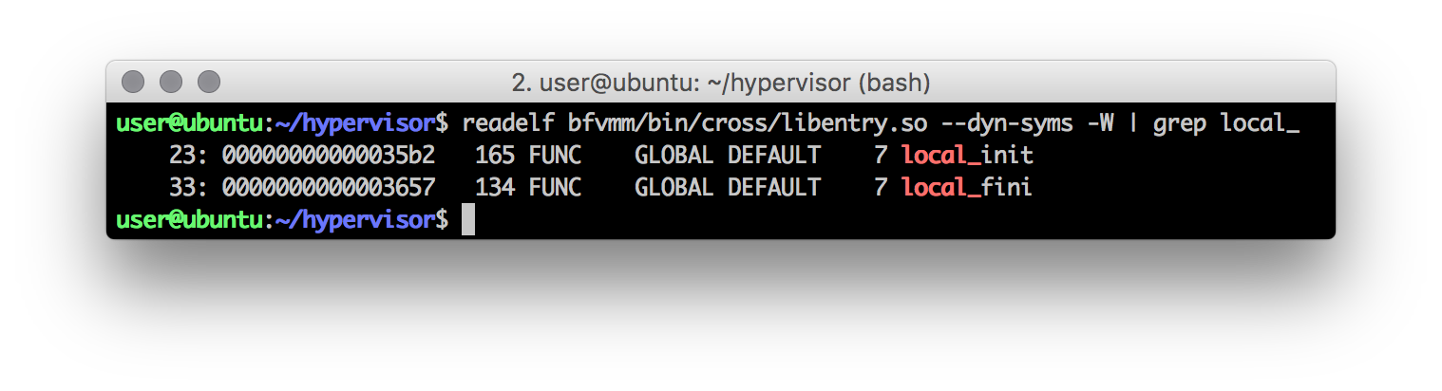
C Runtime Library
We need to provide a C Runtime (ours is called bfcrt) that provides two functions (mimicking crtstuff.c):
local_init
local_fini
This library is compiled as a static library and is linked with every shared library

Slide 16
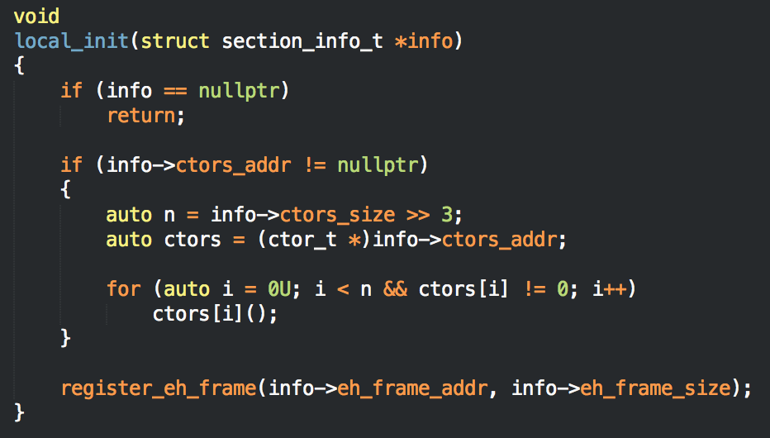
C Runtime Library
Once each module is loaded and relocated using the ELF loader, each module’s local_init function is executed which runs the functions in the .ctor table
We’ll explain this later!!!
Notes:
Notes:
The current implementation also supports init_array, fini_array which are used by Clang, and later versions of GCC
The actual implementation is a little more complicated
When you call ctors[i](), what is it calling?

Slide 17
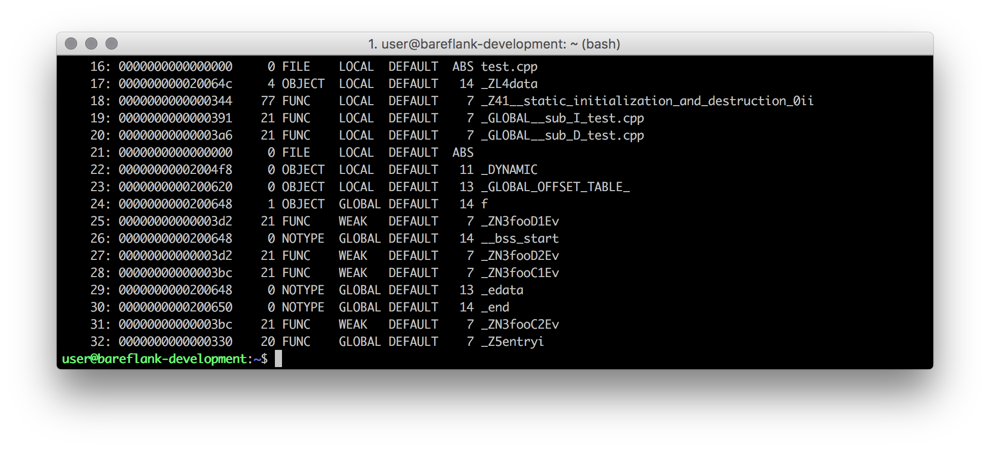

Local Symbols for C/Ds
Notes:
Interesting note:
- All of the constructors and destructors are jammed into a single function.

Slide 18
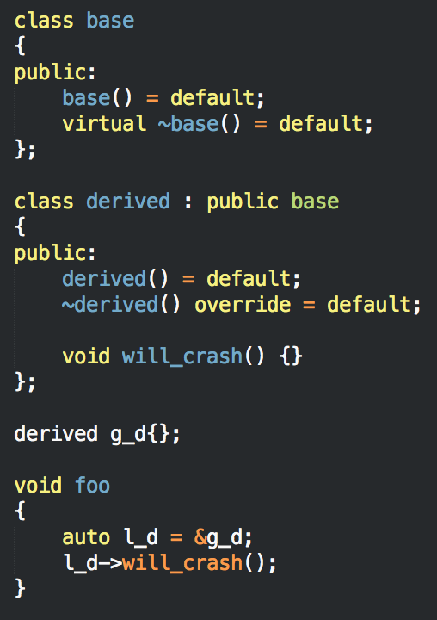
These functions do more than you think!!!
These _GLOBAL__sub functions handle more than just ctor / dtor logic, but also include some relocations.
For example, this code will crash if the _GLOBAL__sub_I_xxx function is not executed.
So make sure you execute your global constructors / destructors, they are not optional in C++
Notes:
OSDev.org would have you believe these are optional, they clearly are not

Slide 19
Red Zone
The main three flags that Bareflank uses (and will continue to need) are: -fpic, -ffreestanding and -mno-red-zone
In particular, -mno-red-zone prevents an issue with the System V spec that causes stack corruption in the kernel (real joy to track down )
http://eli.thegreenplace.net/2011/09/06/stack-frame-layout-on-x86-64/
http://wiki.osdev.org/Why_do_I_need_a_Cross_Compiler%3F#-mno-red-zone_.28x86_64_only.29

Slide 20
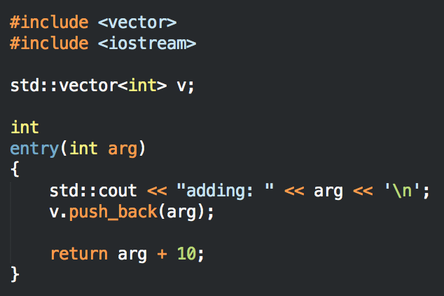
Libc++
What about the Standard Library?
The two biggest libraries are Libc++ and Libstdc++
There are several other more esoteric implementations that have either been abandoned, or do not support C++11/C++14
Libstdc++ / libsupc++ (GNU’s library set) are almost impossible to build when not targeting a specific OS.
http://wiki.osdev.org/Talk:Libsupcxx

Slide 21
Libc++
Advantages
Libc++ / libc++abi (Apple’s C++ library set) on the other hand was:
“Easier” to compile
Supports C++11 / C++14 (and now C++17)
Can be compiled with and without threading support
Can be compiled with and without exception support
Works well with both GCC and Clang/LLVM
Supports the Newlib C library

Slide 22

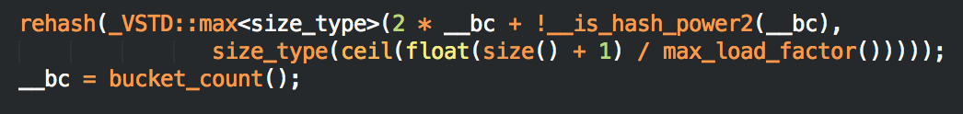
Libc++
Disadvantages
Sadly libc++ / libc++abi are not perfect:
Some functions make heavy use of the stack. This is fine for sane operating systems like Windows and OSX, but Linux only has an 8k stack by default which causes issues.
Some functions (like the unordered_map hash function) use floating point arithmetic which is not supported in the kernel
Some functions use divide / modulo which is also not supported in the kernel

Slide 23
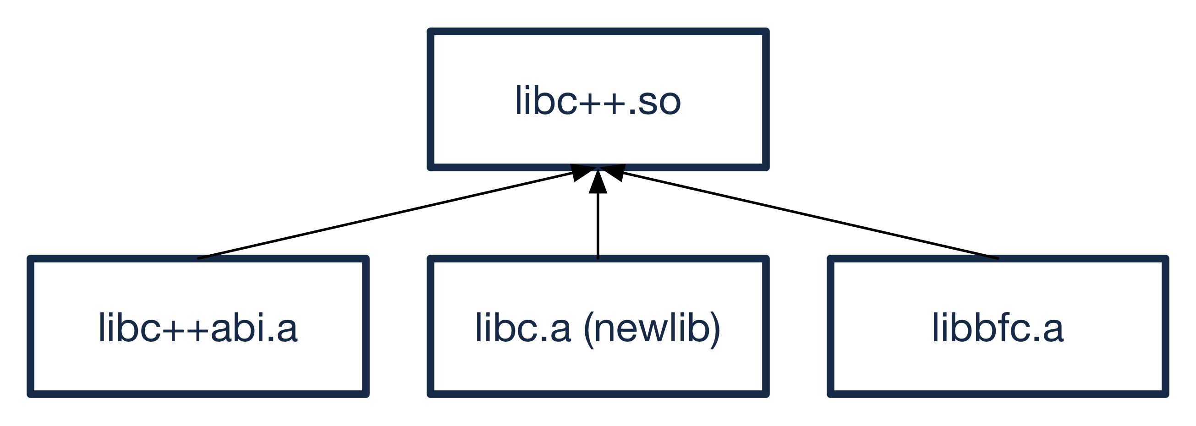
Libc++
Current Structure (will change in the future)
Since newlib doesn’t like compiling shared libraries, we statically compile newlib, libc++abi, and libbfc into libc++
The result is a single libc++.so that is loaded using the ELF loader.

Slide 24
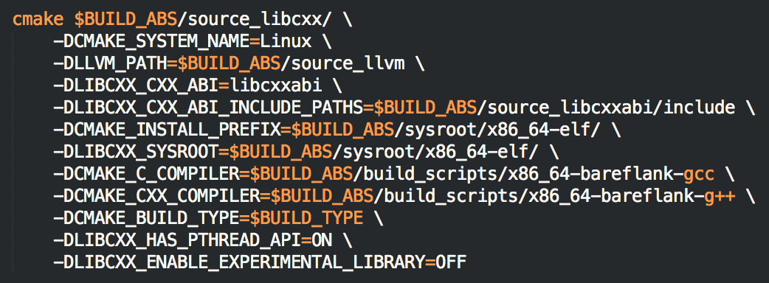
Libc++
Since Libc++ uses CMake, how exactly do we compile it?
CMake is configured to compile using it’s cross-compilation toolchain feature, with some special sauce!!!

Slide 25
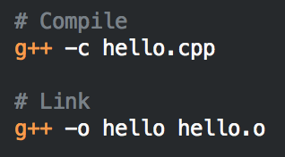
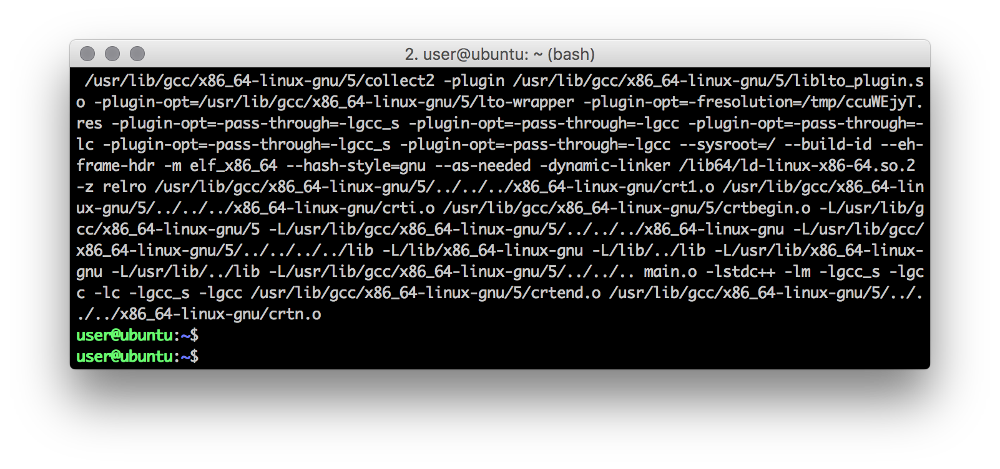

Wrapper Script
When compiling and linking a program, you typically invoke the compiler twice. Once to compile the code, and once to link the compiled object files.
Under the hood GCC does this for you:

Slide 26

Wrapper Script
The extra args are object / header files specific to your OS that are needed to link a program such that it can be run by your OS
Since we provide our own C runtime library and ELF loader, we were left with three possible options:
Patch GCC and Clang to provide the linker args as we need them (for every version of GCC and Clang we decide to support)
Run LD manually (ideal solution)
Create bash wrapper script for GCC/Clang that acts like GCC/Clang, but runs LD manually during linking

Slide 27
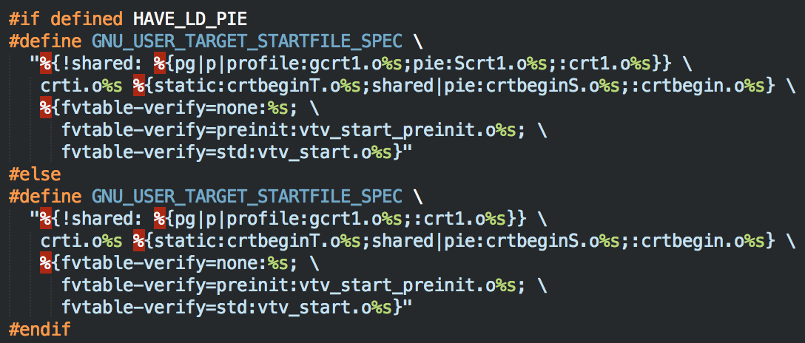
Wrapper Script
Patching GCC
Patching GCC would involve managing code like this for every version of GCC (not to mention Clang):
http://wiki.osdev.org/OS_Specific_Toolchain

Slide 28

Wrapper Script
Seriously?

Slide 29
Wrapper Script
Link Manually
Running LD manually was what we did at first until it came time to compile Libc++ which uses CMake.
CMake expects that you are using the compiler as the linker. In other words, CMake does not seem to have a clean set of variables for the linker like it does for the compiler such as:
CMAKE_C_COMPILER
CMAKE_CXX_COMPILER
https://cmake.org/pipermail/cmake/2014-August/058268.html
One week later, we moved to option #3

Slide 30

Wrapper Script
Really?

Slide 31
Wrapper Script
Winning Option
Bareflank uses a bash script that mimics GCC (and Clang in a week or two). If “-c” is provided GCC/G++ is used, and LD is used otherwise.
No patches are needed to GCC or Clang, meaning Bareflank’s build environment works (so far) on all of the cross compilers we support without modifications (GCC 5.x, 6.x, Clang 3.8, 3.9)
Object files and header include paths are added to GCC/G++ and LD as needed
Ugly hacks are contained in one, easy to script place

Slide 32
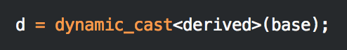
Dynamic Cast
What about dynamic_cast?
If you noticed in previous slides, symbols are marked as either weak or global

Slide 33
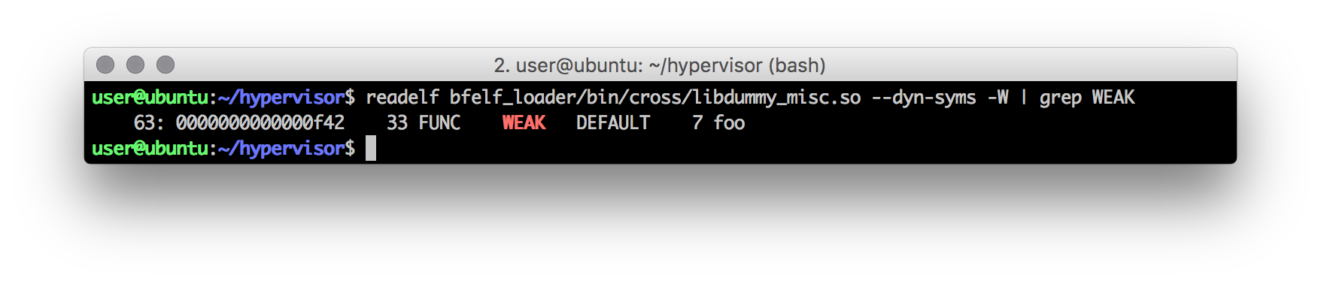
What is a weak symbol?
What if the same symbol is defined twice?
If all but one symbol is marked “weak”, and the remaining symbol is marked “global”, the “global” symbol is used.
Using __attribute__((weak)), GCC will mark a function as weak, telling the ELF loader to pick the strong symbol over the weak symbol
Notes:
This is used for example by the new / delete operators to allow you to globally define your own.

Slide 34
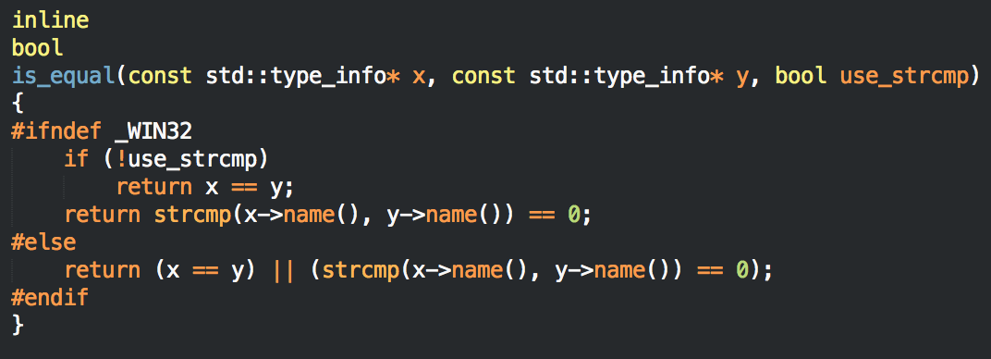
ELF Loader
dynamic_cast<>
What if every symbol is defined weak? Turns out the Itanium C++ ABI states that if this happens, you must use the same symbol for all references in all libraries.
One example of this is GCC marks all std::type_info symbols as weak and dynamic_cast relies on this when it is doing it’s pointer comparisons.

Slide 35

ELF Loader
Oops
https://llvm.org/bugs/show_bug.cgi?id=26785

Slide 36

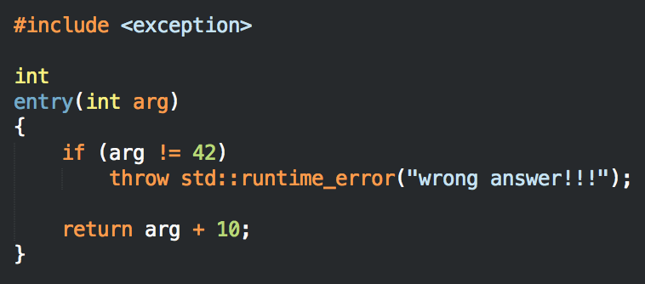
What about exceptions?
Since the Standard Library relies on exceptions, what do we do?
Turning off exceptions using “-fno-exceptions” is equivalent to burying your head in the sand
Use an existing stack unwinder?
Implement our own?
Notes:
Lets look at how this works

Slide 37
Unwind Library
The unwind library’s job is to reverse the function stack, cleaning up each function as it goes (including destroying locally created C++ objects)

Slide 38
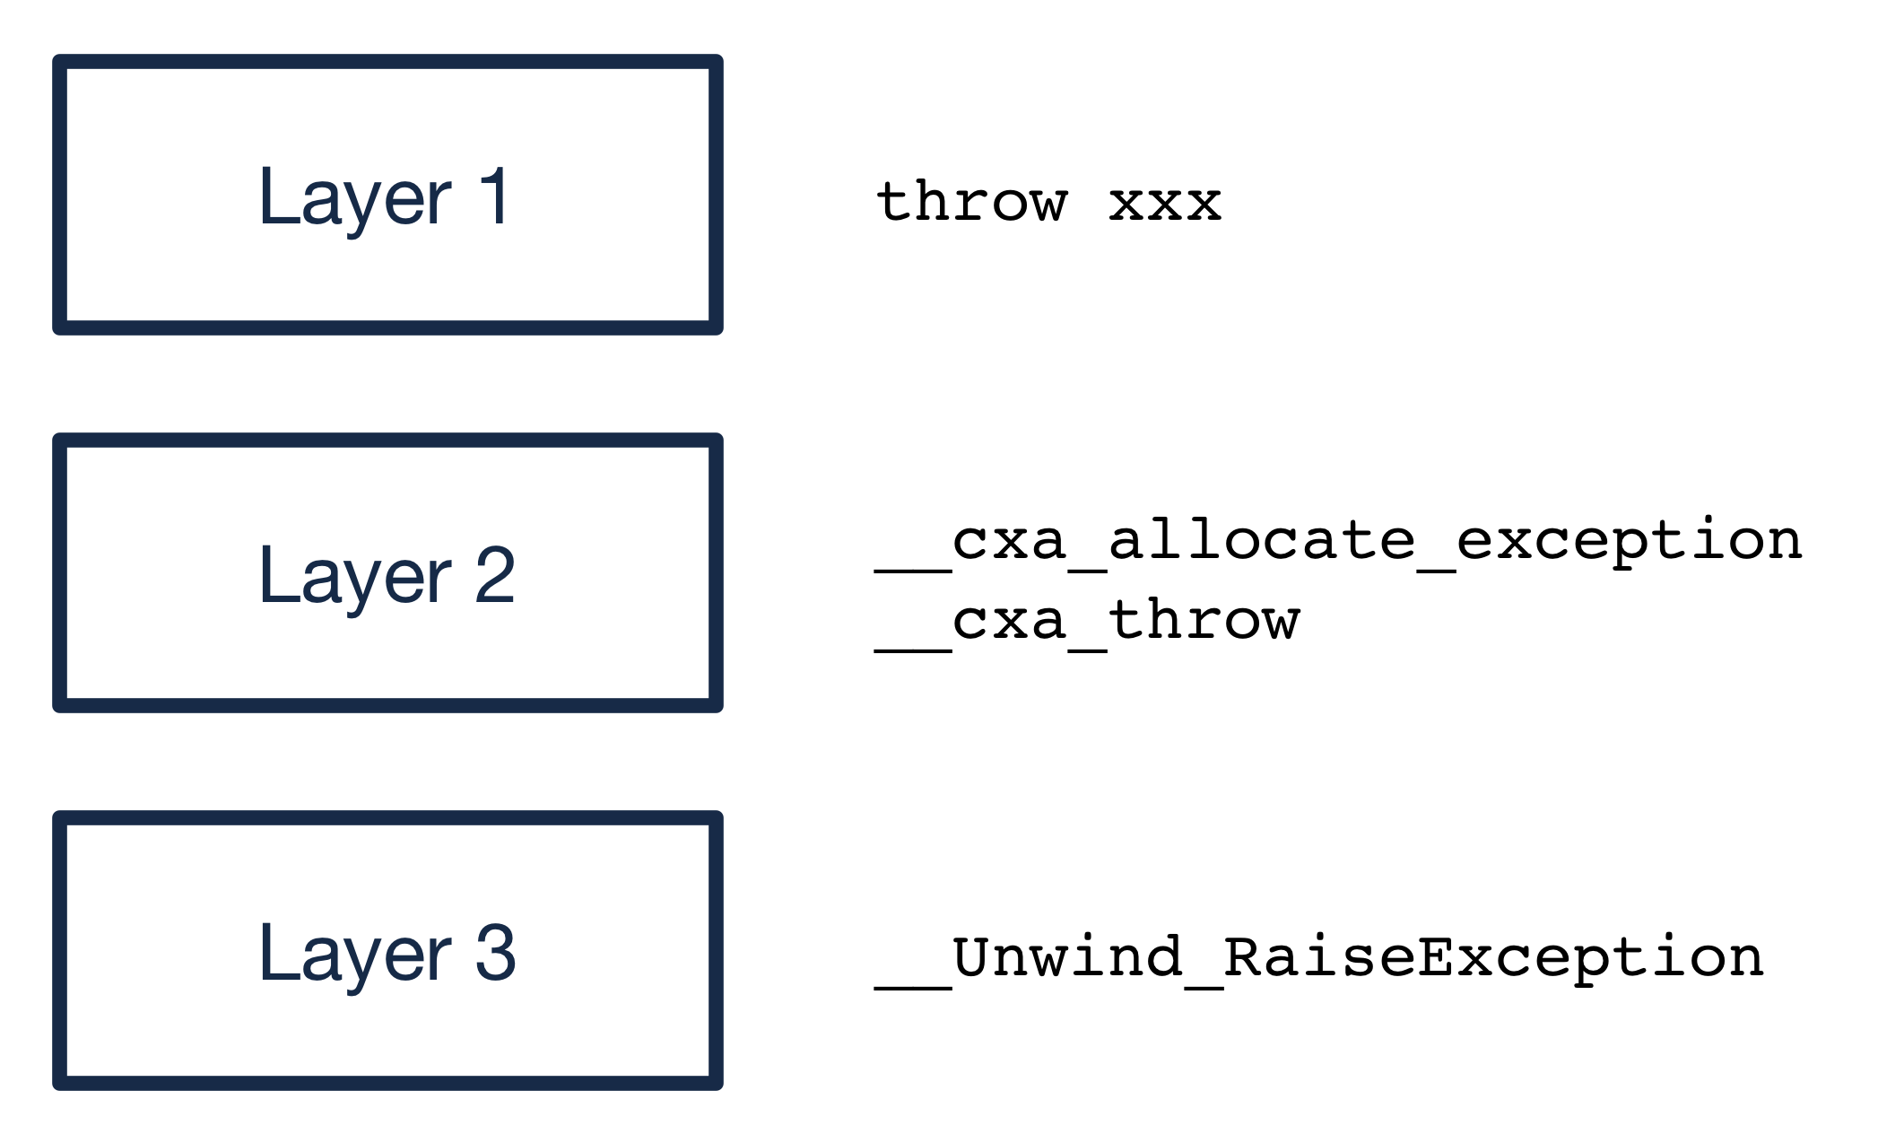
Unwind Library
Overview (continued)
C++ exception support is provided by three layers:

Slide 39
Unwind Library
Layer 1 / Layer 2
Layer 1 is provided by the C++ compiler itself. When you call “throw xxx” the compiler compiles this into a set of assembly instructions which result in a call to:
__cxa_allocate_exception
__cxa_throw
These __cxa_xxx functions are provided by Layer 2, which in this case is the libc++abi library.
http://libcxxabi.llvm.org/spec.html

Slide 40
Unwind Library
Layer 3
Layer 2 is architecture independent, yet C++ exceptions have to unwind the stack, which requires architectural knowledge.
To support this Layer 2 calls into Layer 3 functions, which on x86_64 is defined by the IA64 C++ ABI. https://mentorembedded.github.io/cxx-abi/abi.html
In this case, _Unwind_RaiseException is called which resides in the “unwind” library and actually performs the stack unwinding

Slide 41
Unwind Library
Why Custom?
Currently the three major libraries that provide Layer 3 support include:
Libgcc
Libunwind (Google)
Libunwind (Apple)
All three of these libraries are designed for user-space and thus rely on thread support, malloc/free, and various other libraries that are not available in our C++ environment
For these reasons, we decided to write a custom, kernel-safe, thread-safe unwind library

Slide 42

Unwind Library
Spec Complexity
The unwind library relies on several specs to work:
DWARF4: http://www.dwarfstd.org/doc/DWARF4.pdf
LSB: https://refspecs.linuxfoundation.org/LSB_5.0.0/LSB-Core-generic/LSB-Core-generic.pdf
IA64 C++ Spec: https://mentorembedded.github.io/cxx-abi/abi.html
System V Spec: http://www.x86-64.org/documentation/abi.pdf

Slide 43
Unwind Library
As promised!!!
The process starts in bfcrt, were a call is made to register the “.eh_frame” location and size with the unwinder.

Slide 44
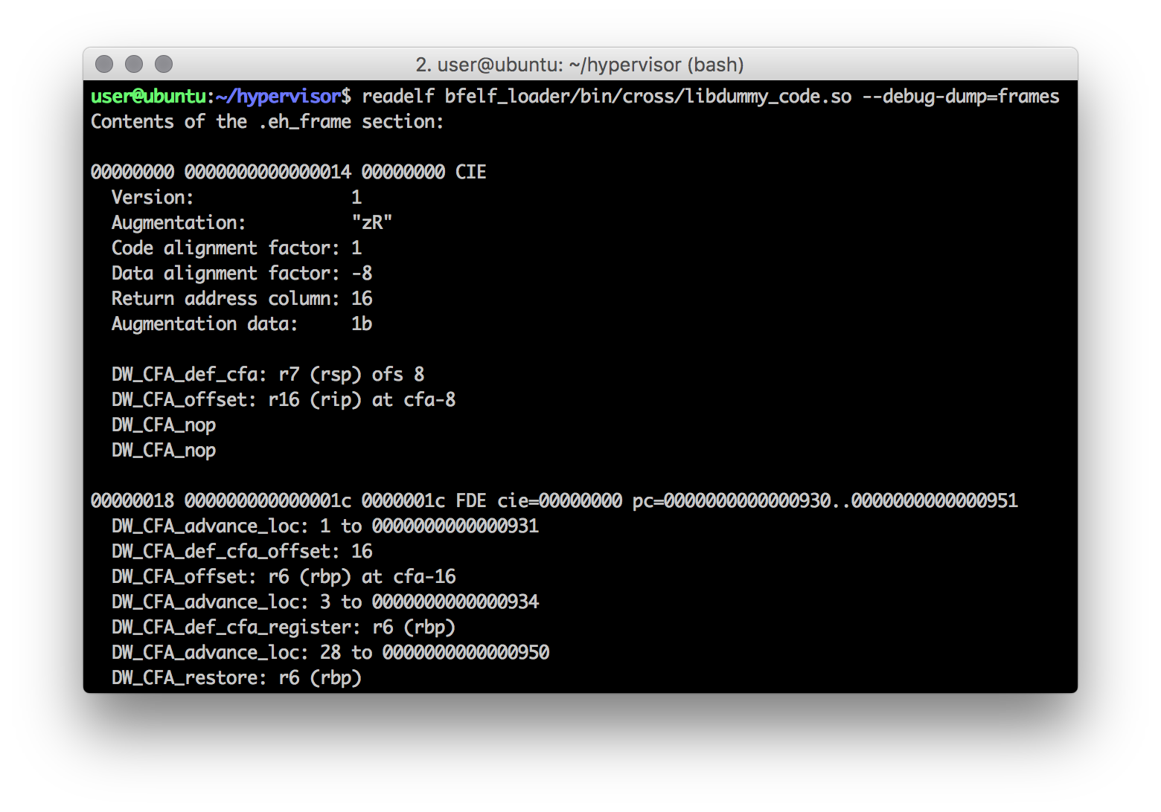
Unwind Library
DWARF4
The format of the information in “.eh_frame” is defined by the LSB and DWARF4 specs. This section stores the instructions on how to undo each stack frame in the code in a DWARF4 compressed format.

Slide 45
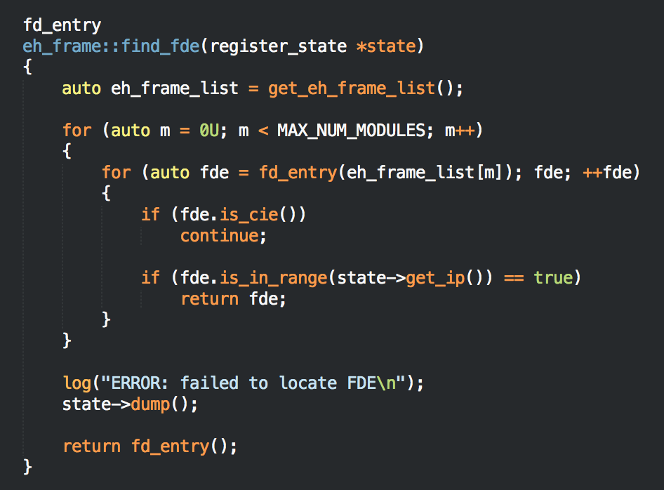
Unwind Library
Locate FDE
When an exception is thrown, the unwind library takes the current stack pointer and locates the stack frame information in “.eh_frame” for that pointer

Slide 46
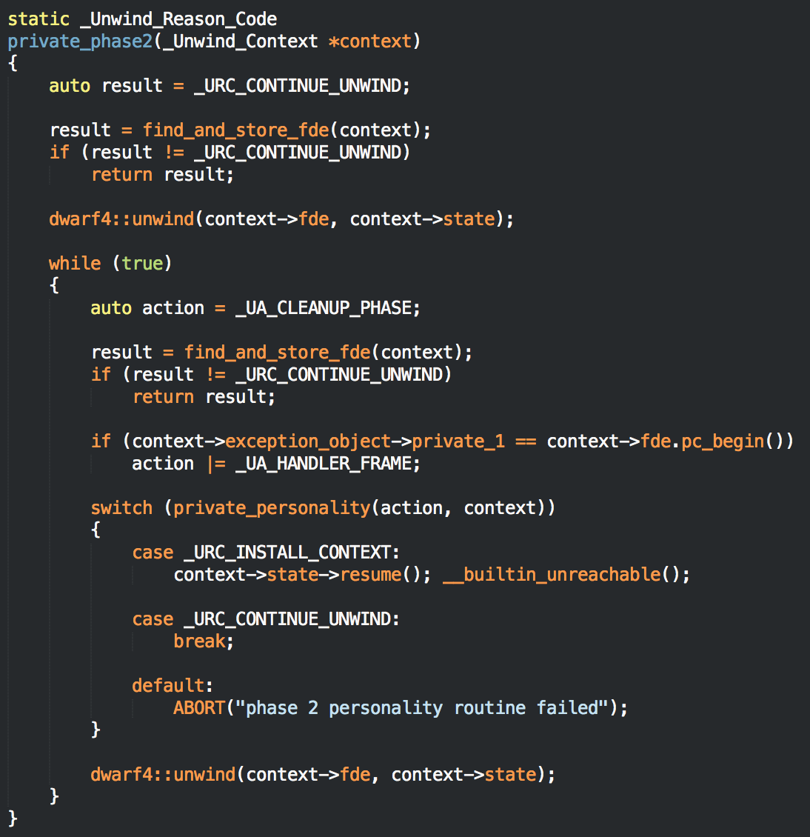
Unwind Library
Notes:
The stack information is provided to a personality function that tells us if we have found a catch block, or if we need to continue to unwind, or if a failure has occurred. This process is repeated until a catch block has been found, or std::terminate() is called.

Slide 47
Recent Accomplishments
Have support for Travis CI, AppVeyor, Coveralls, Coverity Scan, Clang Tidy, Google Sanitizers and the CII Best Practices
Include support for Microsoft’s GSL and the C++ Core Guidelines: www.github.com/microsoft/gsl
Provide support for GCC 5.x, GCC 6.x, C++11/14 and Clang 3.8 / 3.9 support in coming soon!!!

Slide 48
Future Work
macOS support is planned for hopefully sometime next year.
ARM support should be starting soon
UEFI support (both for the hypervisor, but also to generically support C++ applications in UEFI)
Extended API and HyperKernel extensions
IncludeOS
Custom Libc specifically to support Libc++ (likely useful for other projects as well)

Slide 49

Questions
www.bareflank.org
www.github.com/bareflank/hypervisor
Notes:
There are a lot of other things like TLS, mutex support, libc functionality like memory allocation, and IO read/write that we don’t have time for.

